Slide 1
Sitecore Content Hub 4.0 SITECORE USER GROUP PPT Sep 10, 2021

Slide 2
Sitecore Content Hub Modules
DAM
CMP
PCM
MRM
Legend:
DAM – Digital Asset Management
CMP – Content Marketing Platform
PCM – Product Content Management
MRM – Marketing Resource Management

Slide 3
Sitecore Content Hub Design Models
Repository Model
Domain Model
Entity Model
Single source of truth – Upstream / downstream data – 360 degree view – Digital Assets, user and file metadata
How items get described, structured and linked
Set of data that belong together – Entity and relationship go together

Slide 4
Sitecore Content Hub Sandbox Working
How Sandbox setup internals (probably) work?
Cloud-based Service and setup through background job processing. Works same way for Create / Start / Stop / Reset etc.
Various Status during Creation:
CreateRequested
QueuedforCreation
Creating
CreatePostProcessing
ApplicationPostProcessing
Started
Starting
Running
Request
CreateRequested
QueuedforCreation
Create
Creating
Perform (any) Post processing
Post Processing
Start
Started
Running
User
Azure Job
Azure Service

Slide 5
Sitecore Content Hub Sandbox Working
How Sandbox setup internals (probably) work?
Status during various states
Various Status during Creation:
CreateRequested
QueuedforCreation
Creating
CreatePostProcessing
ApplicationPostProcessing
Started
Starting
Running
Various Status during Stop:
StopRequested
StopQueued
Stopping
Stopped
Various Status during just Start:
StartRequested
StartQueued
Starting
Started
Running
Various Status during Reset to initial state:
Clears the sandbox completely and gets back to initial state
ResetRequested
ResetRequestQueued
Resetting
ResetRequestPostProcessing
ApplicationPostProcessing
Starting
Running

Slide 6
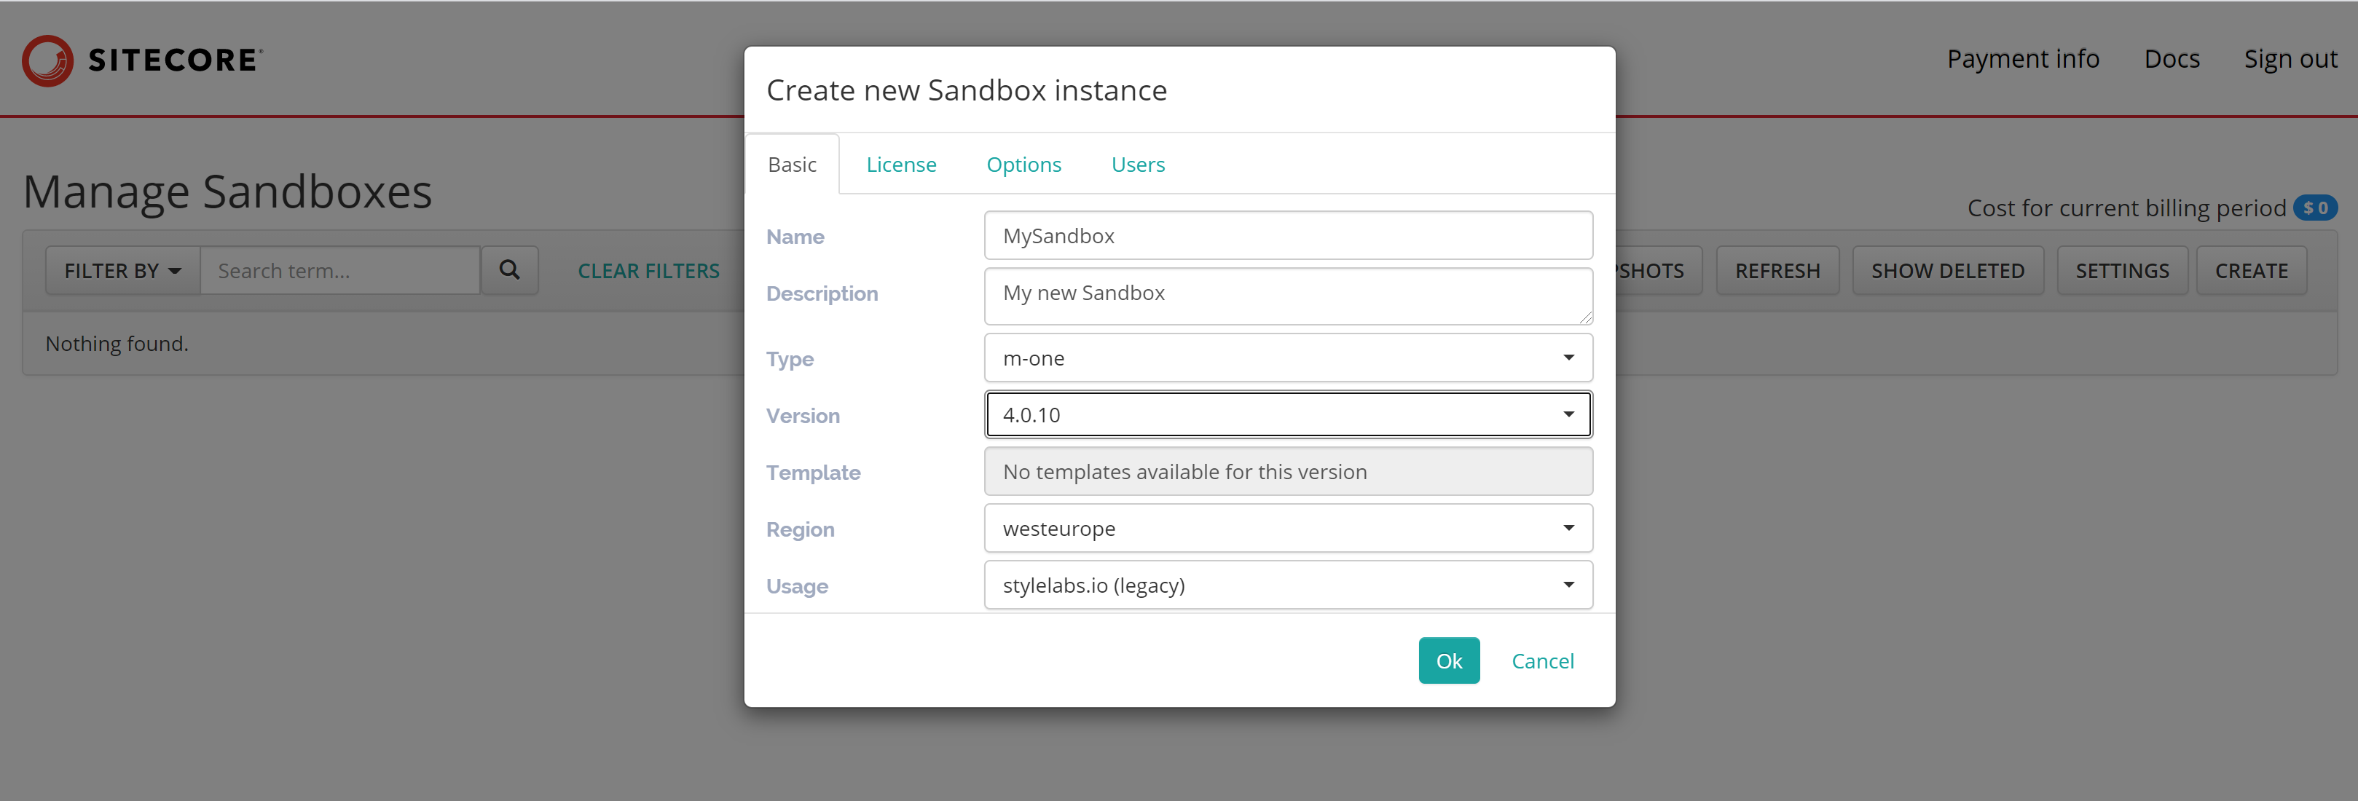
Sitecore Content Hub 4.0
Sandbox Creation Portal: create.stylelabs.io
USD350 Payment

Slide 7
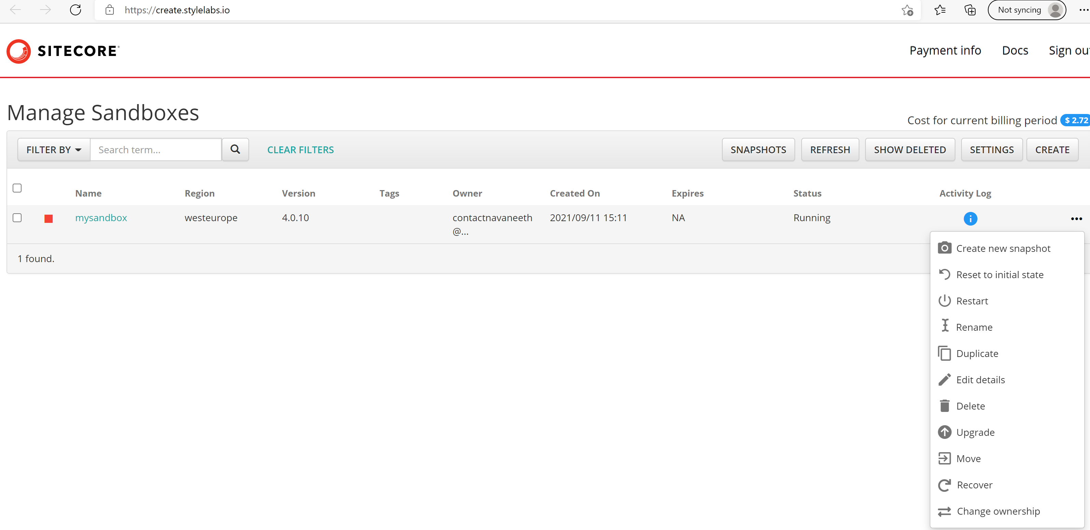
Sitecore Content Hub Sandbox Options

Slide 8
Sitecore Content Hub 4.0 New Features
Soft deletion
Sharing experience: share via email
Entity drafting
Cold storage
Sharing experience: Add to entity operation
Entity variants

Slide 9
Asset Stages
Created
Approved
Reviewed
Submit
Approve
Created
Rejected
Reviewed
Submit
Reject

Slide 10
Direct Publish Asset
Direct Publish
Created
Approved
Reviewed
Submit
Approve

Slide 11
Sandbox Pages
Create
Review (Waitingroom)
Assets
Manage (admin)
Home
Collections
Asset Details (Asset)
Annotations

Slide 12
Asset – Rendition Relationship (1- *)
Rendition-1
Asset
Rendition-2
Rendition-3

Slide 13
Sitecore Content Hub Asset Lifecycle
Asset state within Content Hub:
Create
Upload Assets
Review
Inline Preview
Asset(s)
Asset details
Annotate
Collaborate
Approve / Reject
Download

Slide 14
Sitecore Content Hub Annotation tools
Different tools to annotate different assets -
 | Image Assets | PDF Assets | Audio Assets | Media Assets
Freehand tool |  | 
Text tool |  | 
Shape tool |  | 
Comment tool |  |  |  | 
Search tool |  | 
Time-based annotation |  |  |  | 

Slide 15
Sitecore Content Hub Annotation Comm
Asset annotations can be shared with people who do not have access to the portal
Pre-requisites (Print templates):
AnnotationReportPdf
AnnotationReportAudioVideo
Annotation PDF Report
Downloads
(myorders)
Annotation (External) Communication
@mention
E.g., @contactnavaneeth@gmail.com

Slide 16
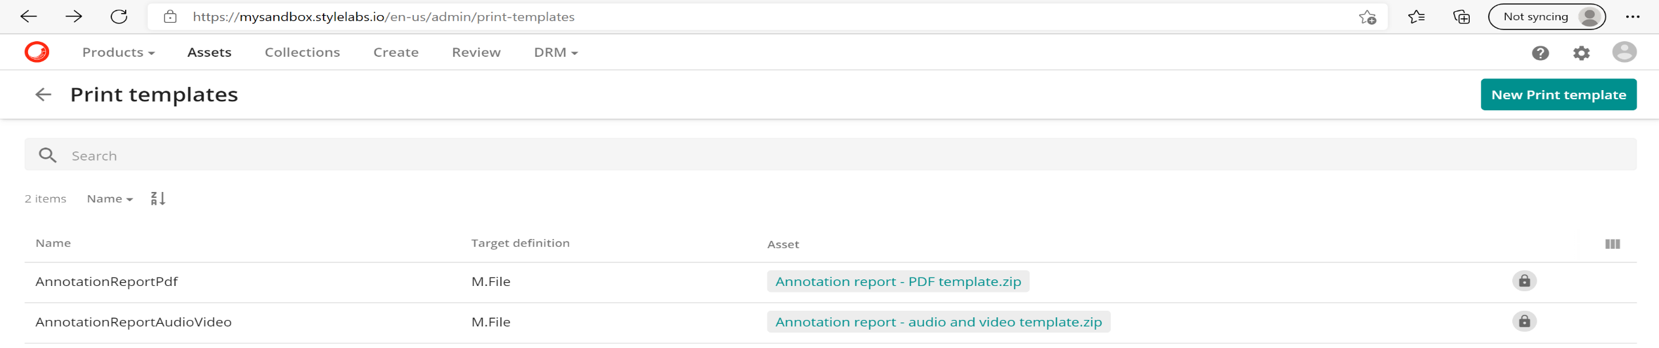
Sitecore Content Hub Print templates
An admin page that gets automatically setup without user intervention -

Slide 17

Asset Versioning Principle
Compare
Version-1
Compare
Master
Version-2
Version-3

Slide 18
Sitecore Content Hub Asset Versioning
Features:
Upload new files (in Asset details page) to create new versions
Maintain all other references to original
Master file denoted by crown icon
Find Duplicate files
Compare to master (due to second principle above)

Slide 19
Sitecore Content Hub Asset Download
Download
Download Options
(OrderCreation)
Downloads
(myorders)
Assets
Confirm

Slide 20
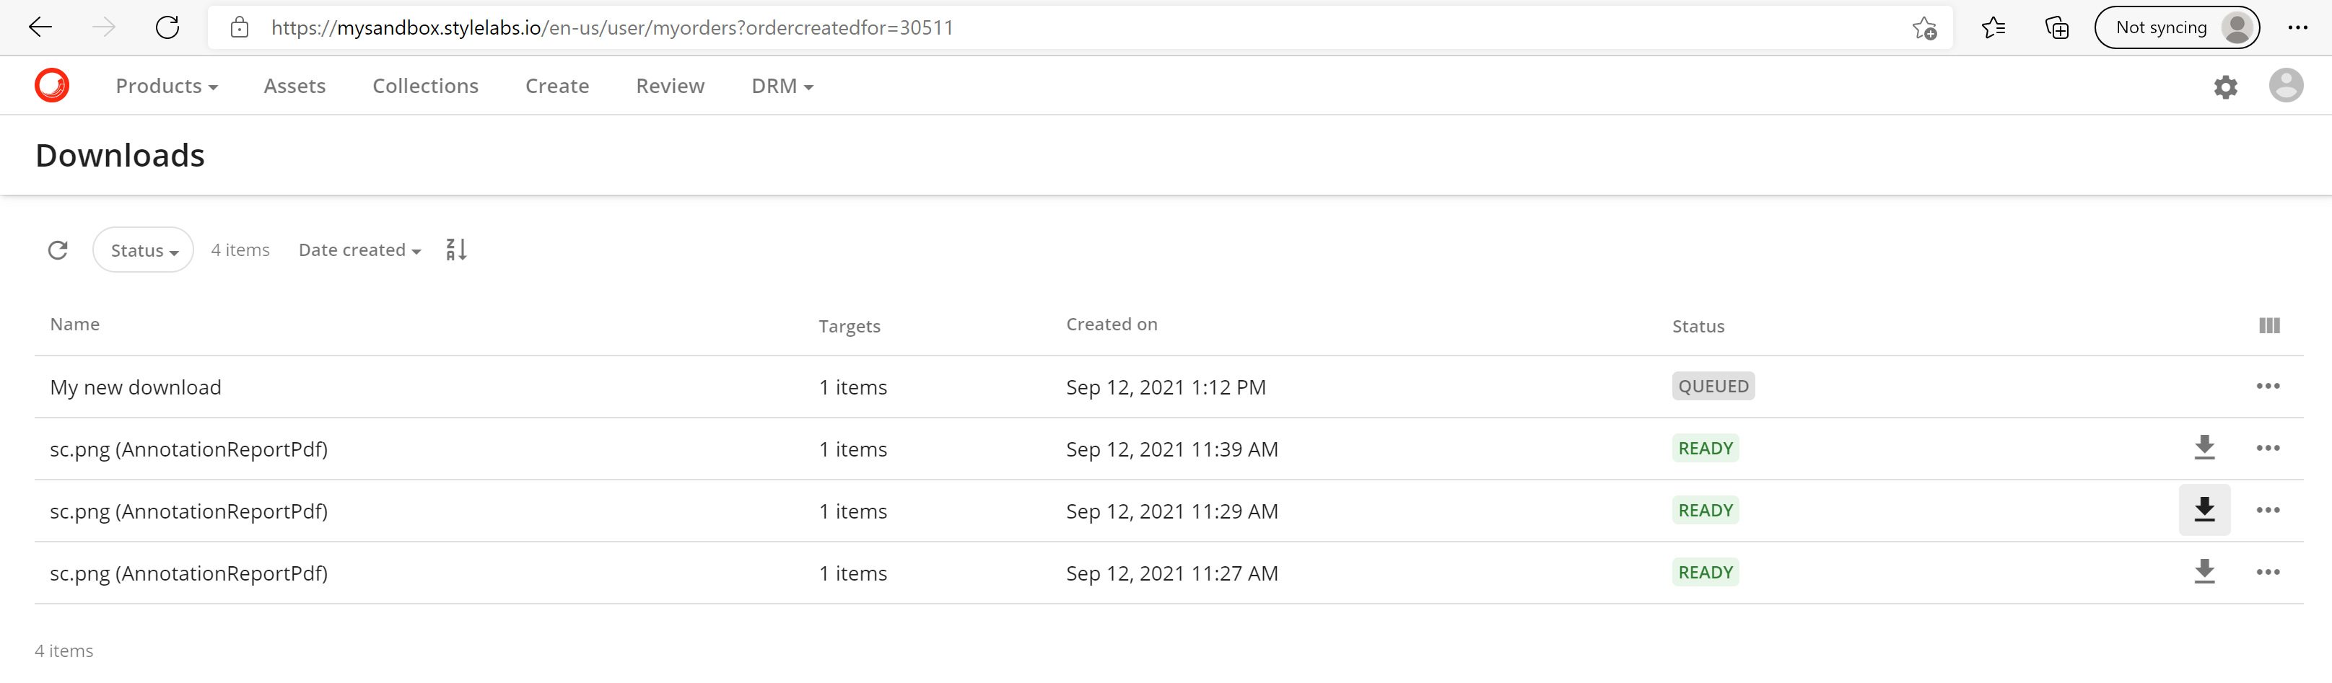
Sitecore Content Hub Downloads Page
Everything is job-based, Job Status page here:

Slide 21
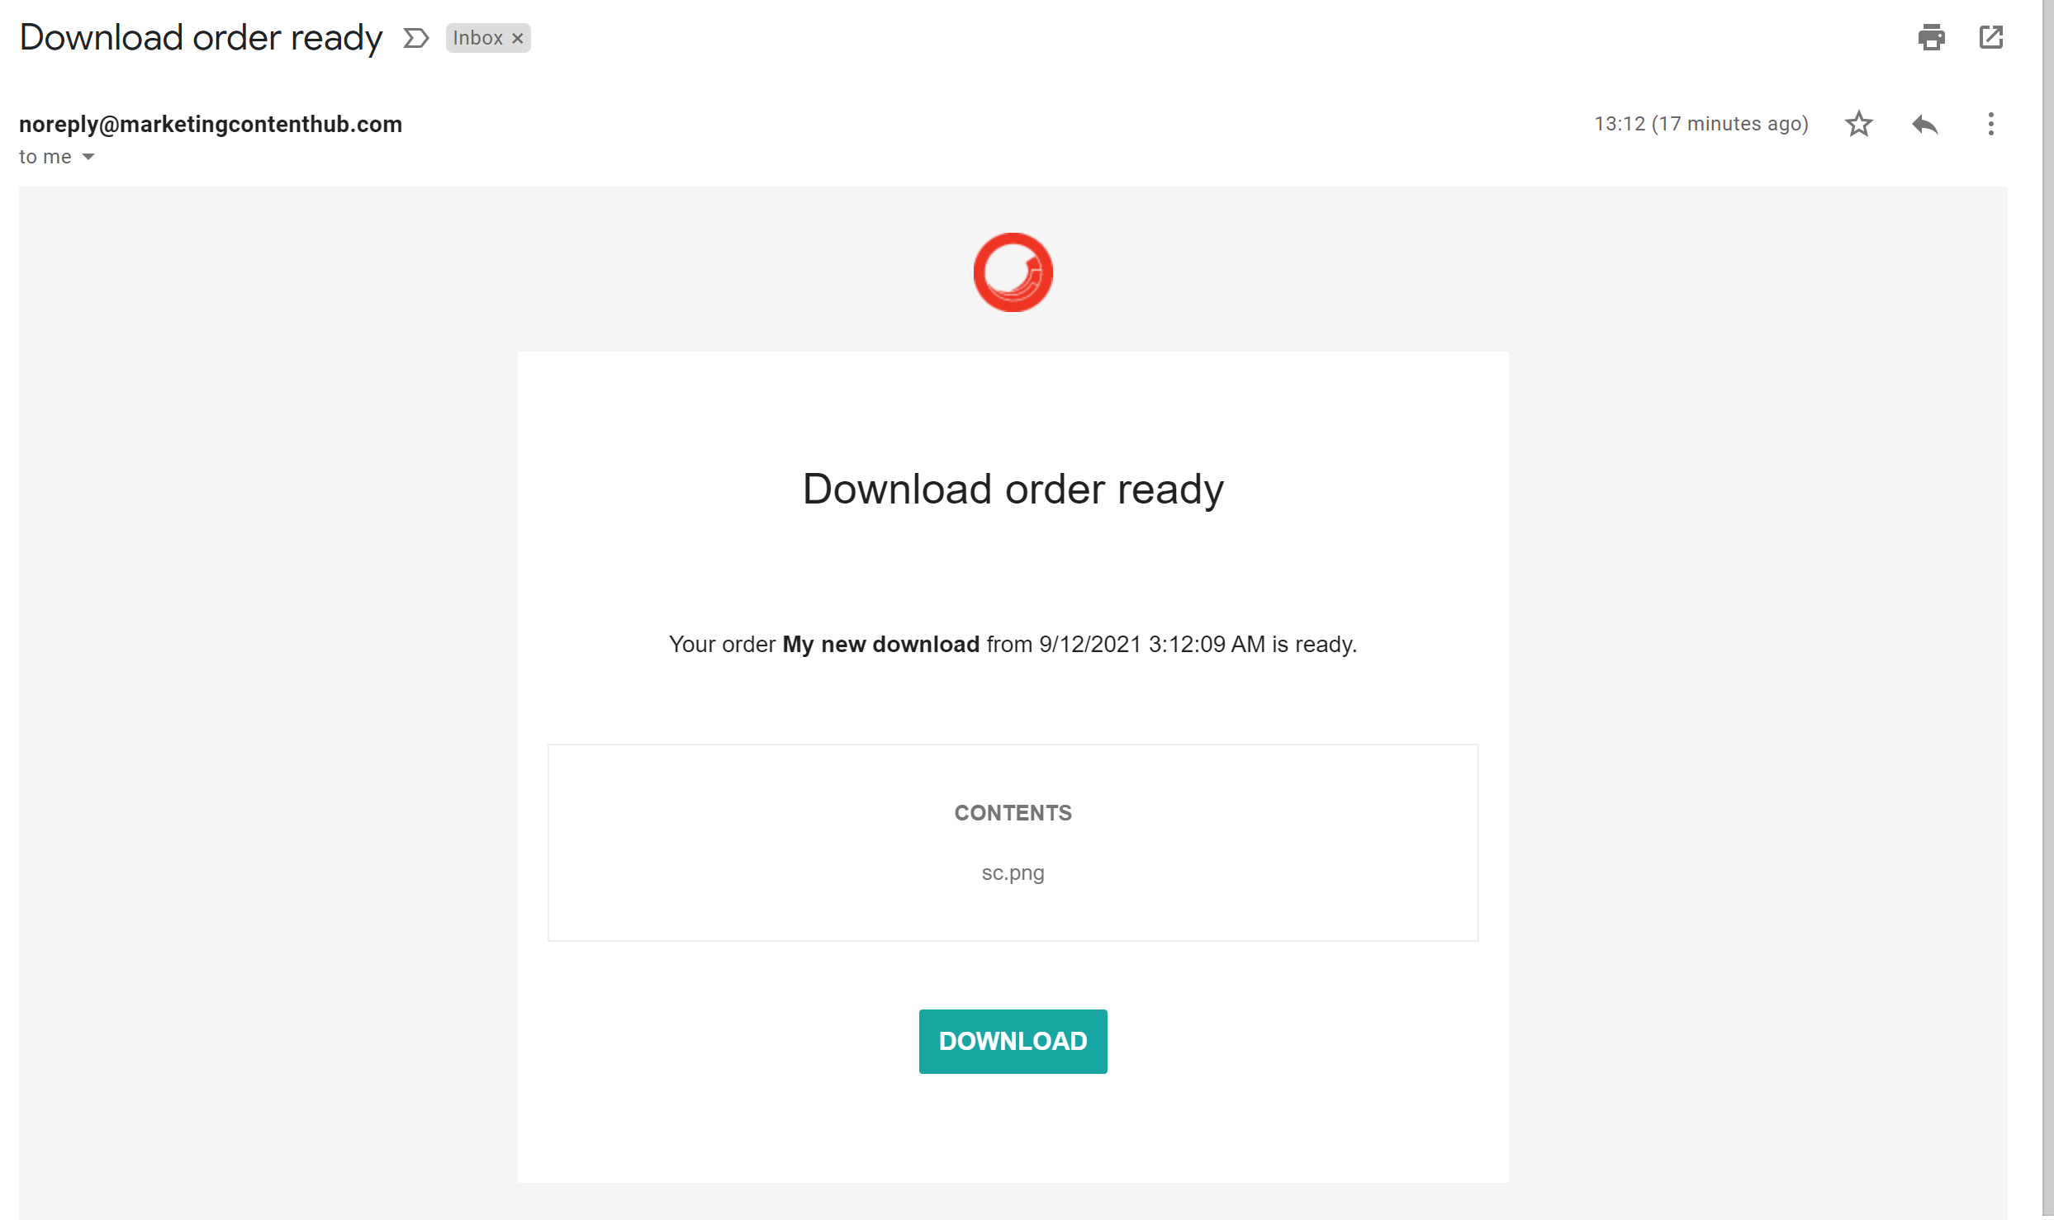
Sitecore Content Hub Order Download
Everything is job-based so, get notification email on ready status -

Slide 22
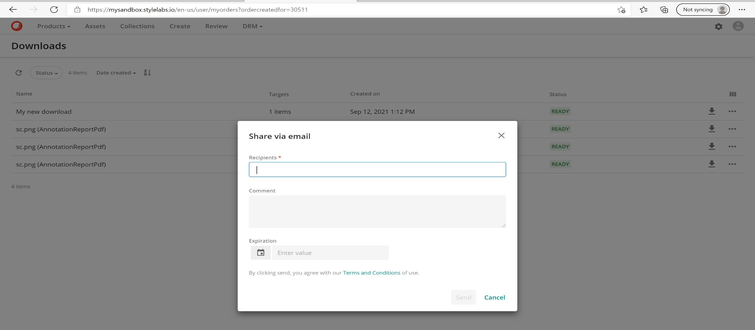
Sitecore Content Hub Share via Email
Share assets via email -

Slide 23
Sitecore Content Hub Admin User
Reset Password (Email link)
Disable User
Edit User (Email Address)
Admin User
Features with respect to User Creation :
- Create New User
Lock User after a time period
Disable User
Provide Specific module access
Impersonate User
Provide Email Address /
Reset Password Link
Create User / Access
Impersonate User
Lockout User
Lockout Until Date Time

Slide 24
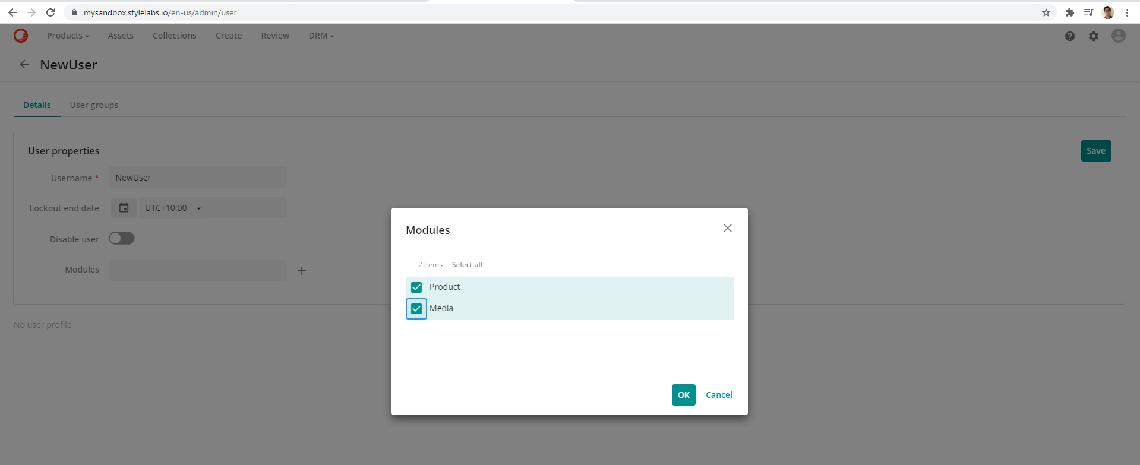
Sitecore Content Hub Create User
An administrator can create a new user -

Slide 25
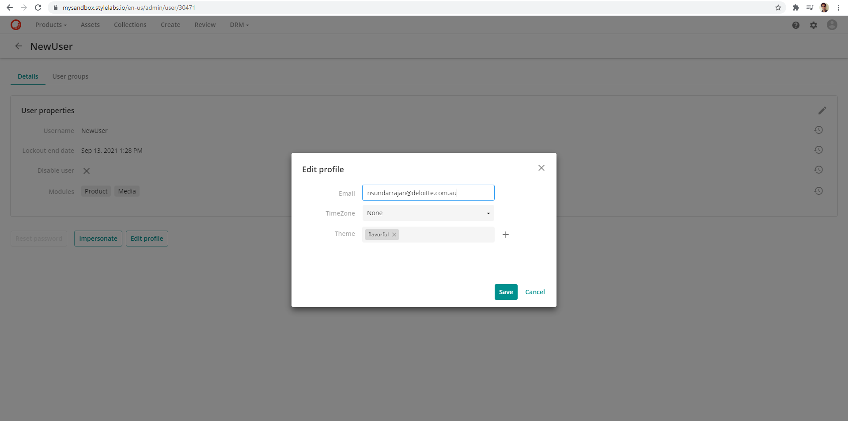
Sitecore Content Hub Edit User
An administrator can edit a new user and a Reset Password button will be enabled to email link to the new user -

Slide 26
Sitecore Content Hub Collections
Collection is approved assets + comments
Collaboration Techniques:
User Access
Share link
Approved Assets
Comments
User
User(s)
Collaborate
Share collection with one or more users for collaboration

Slide 27
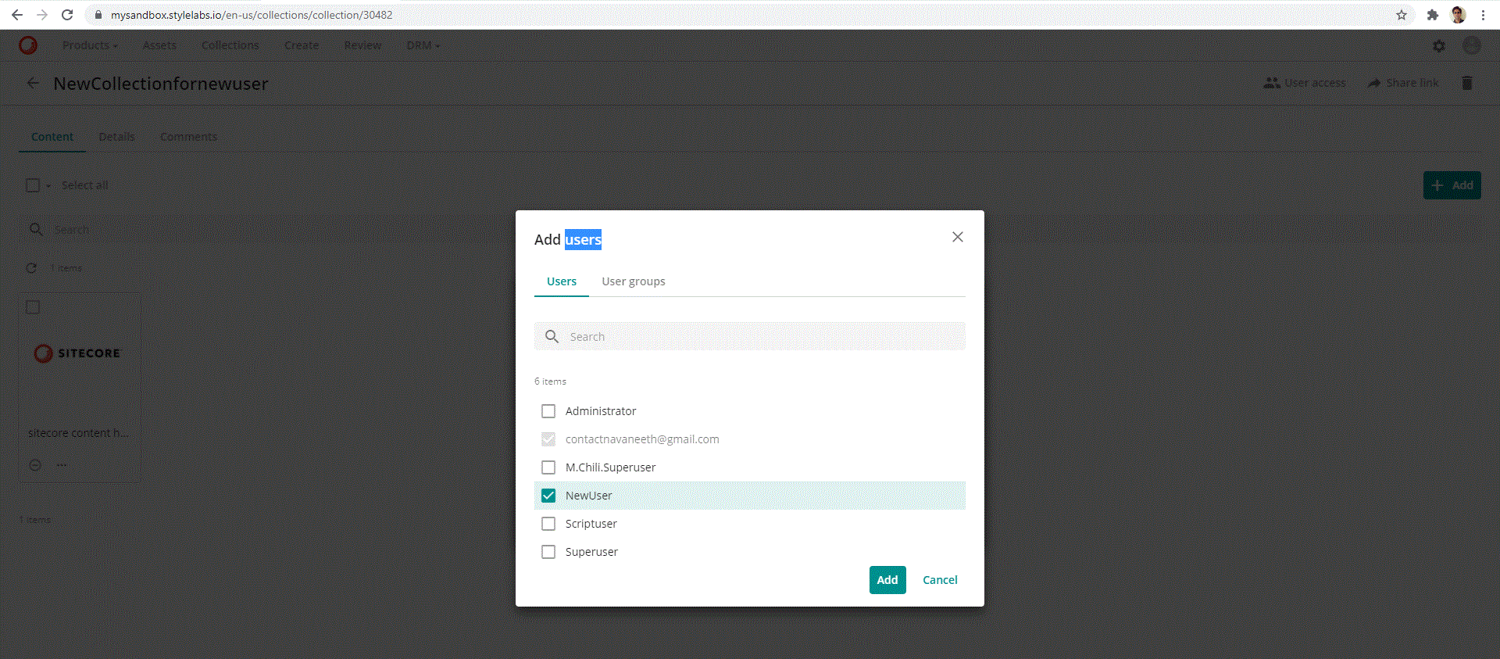
Sitecore Content Hub Collections
User Access: Allocate collection to one or more “internal” users so that they can collaborate on next login

Slide 28
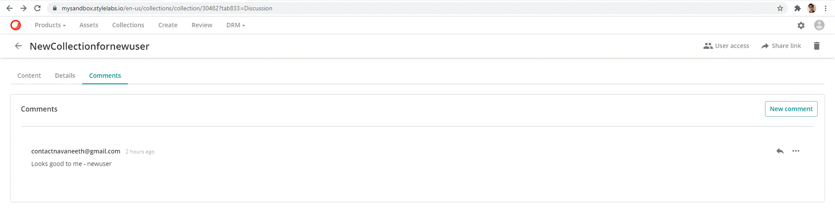
Sitecore Content Hub Collections
User Access: Access collection on next login

Slide 29
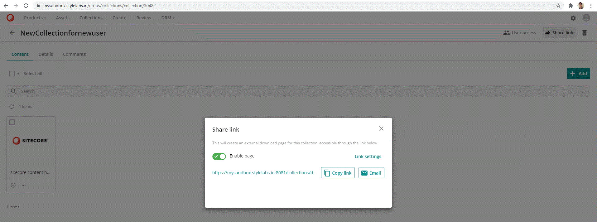
Sitecore Content Hub Collections
Share link: Allocate a collection to one or more “external” users through (email) link - Generate custom URL using Link settings

Slide 30
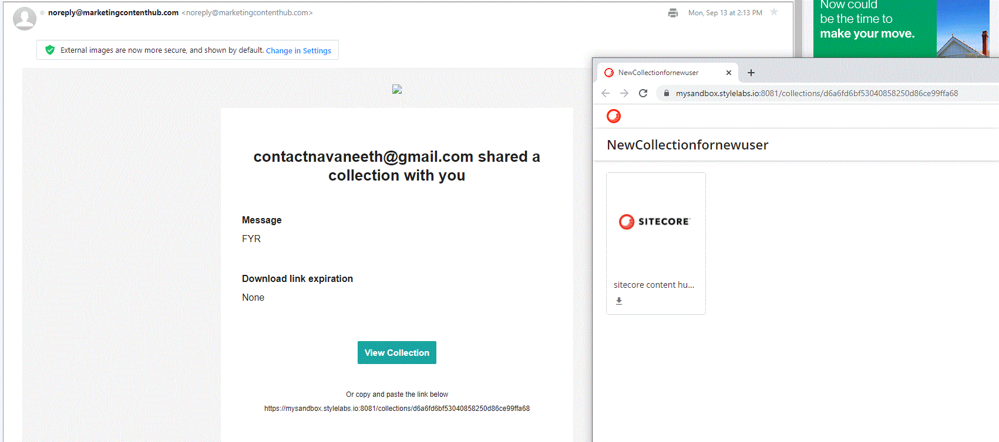
Sitecore Content Hub Collections
Sample email with shared collection URL

Slide 31
Sitecore Content Hub Collections
Sample email with shared collection URL

Slide 32
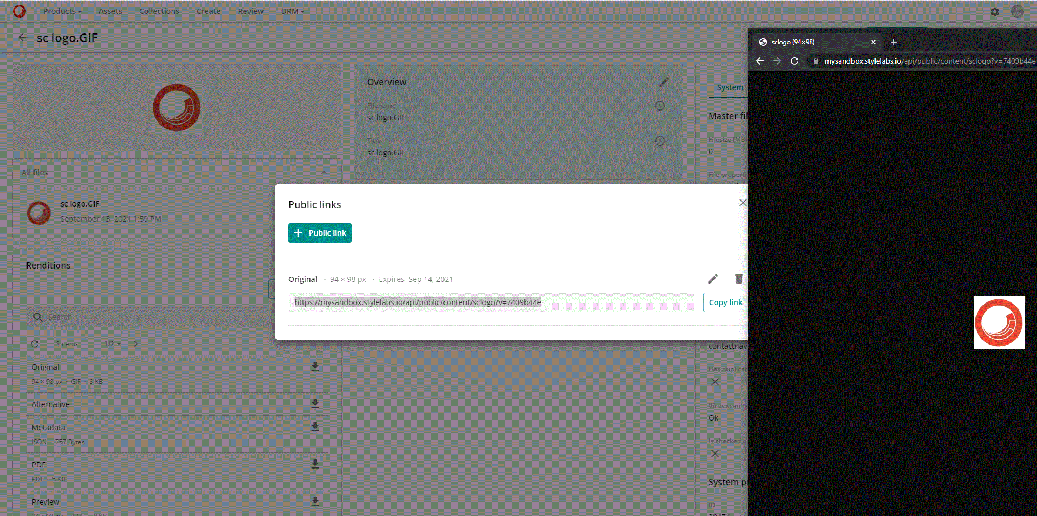
Sitecore Content Hub Public Link
Create Public link for image(s) along with expiry date
Other Features:
Image merger
Image transformation

Slide 33
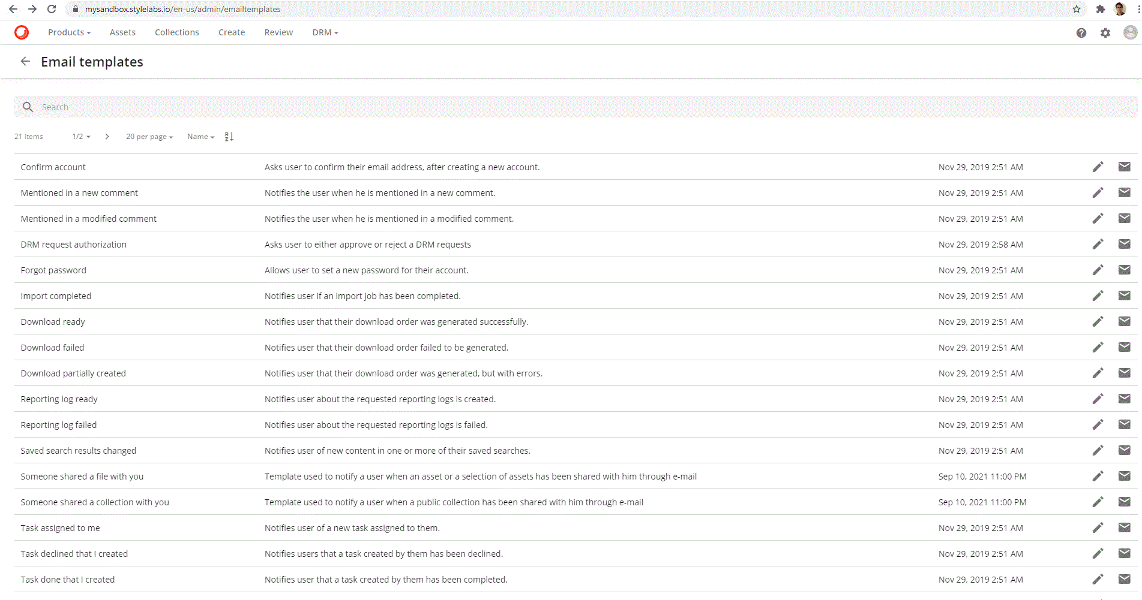
Sitecore Content Hub Email Templates
Customizable email templates part of the admin area

Slide 34
Sitecore Content Hub Page Administration
Concept of composition:
Page ->Comprises of multiple Components
Component -> Comprises of multiple Operations
Components
Operations
Page

Slide 35
Sitecore Content Hub Page Administration
For instance, Move to Trash, Delete are all operations added to a component
Operations
Selection Component
Assets Page
EntityOperations Component
Asset Details Page

Slide 36
Sitecore Content Hub Schema relationship
Schema: Comprises of members like Property and Taxonomy definitions
Entity: Copy or Object instance of Schema
Property: Simple types like string, numeric, option list etc.
Taxonomy: Significant in grouping, of business value, facets, hierarchical, > 10 values else use option list
Schema
(M.Asset)
Property
(E.g.,OptionList)
Schema
(M.Asset)
Members
Taxonomy
Entity
(Asset)

Slide 37
Sitecore Content Hub Page / Schema
Page is composed of Components
Components’ members are grouped as per schema
Details Component
Asset Details Page
Schema
(M. Asset)

Slide 38

Sitecore Content Hub Asset Delete Flow
TrashCleaner Settings (Retention Period
Soft Delete: Asset Details Page -> Trash
Retention period – 30 days (default)
Restore
Deleted
Asset
Move to trash
Expiry
Permanent Delete

Slide 39
Sitecore Content Hub Variants / Drafts
Only the following entities support variants and drafts
 | Variants | Drafts
M.Brand |  | 
M.Content |  | 
M.PCM.Catalog |  | 
M.PCM.Product |  | 
M.PCM.ProductFamily |  | 
M.Asset | 
M.Chili.Publication | 

Slide 40
Sitecore Content Hub to Commerce Synch
Configuration Steps: For DAM product assets to get synchronized automatically in XC on addition or modification in CH
Content Hub
Commerce
1. Triggers and Actions
2. Content Hub to Commerce XC Connector
3. Authoring Environment

Slide 41
1. Configure Triggers and Actions
Configure entity type trigger based on a set of conditions to push message to Azure Service Bus Topic
Content Hub
Azure Service Bus
Trigger- 1
Connnection String
Trigger- 2
Topic
Trigger -3

Slide 42
2. Configure CH to XC Connector
Configured on the Minions using Plugin.ContentHub.PolicySet-1.0.0.json to pull product (asset) data from CH via message in Azure Service Bus Topic
Plugin.Sample.ContentHub.AzureServiceBusPolicy
Plugin.Sample.ContentHub.SynchronizationPolicy
Plugin.Sample.ContentHub.ContentHubClientPolicy
Plugin.Sample.ContentHub.ProductSynchronizationPolicy
Plugin.Sample.ContentHub.AssetSynchronizationPolicy
Holds the connection to Azure Service Bus Topic
Entity type and key definition for synchronization between systems
Content Hub Endpoint details
Product property mappings
(Image) Asset Synchronization details

Slide 43
3. Configure Authoring Environment
Configured on the authoring environment JSON to display the product assets in XC Business Tools
For e.g., PlugIn.Habitat.CommerceAuthoring-1.0.0.json
Plugin.Sample.
ContentHub
BizFxPolicy
Bootstrap
Add
Save Config

Slide 44

Modify User Interface
Administrators have the following capabilities -
New Theme
Customize Portal Appearance
New Language
Import Translations
Mass-edit table
Setup Metadata Interface
Administrator
Restrict visibility
Search Component
Configure Search Features
Facets

Slide 45

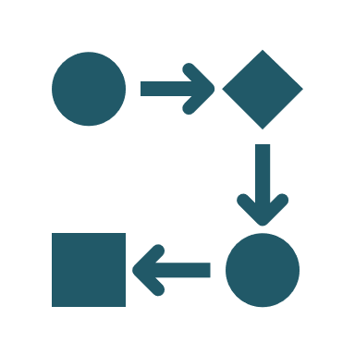


Media Processing Flow
Job processes multiple sets
Each set comprises of a workflow
Workflow comprises of tasks
Workflow - takes an asset and produces multiple renditions
Set
Flow
Asset
Renditions
Job Processing

Slide 46
Sandbox Instance Edit Details
Sandbox instance (missing) Menu options:
Print
Assets
Create
Project
Collections
Administrator
Products
Review
Content

Slide 47
Sandbox Instance Create
Print
Assets
Create
Collections
Project
Administrator
Products
Review
Content

Slide 48
Background processes – myjobs page
Job types processed by Sitecore Content Hub
Distribution
PrintEntity Generation
Checkin
Job Scheduler
Checkout
Discard
Download
Content Publishing
Upload
Fetch
Import
MassEdit
Processing

Slide 49
References
Learning.sitecore.com
https://docs.stylelabs.com/contenthub/4.0.x/content/user-documentation/get-started/content-hub/get-around/user-menu/my-trash.html
https://docs.stylelabs.com/contenthub/4.0.x/content/user-documentation/manage/data/taxonomies/taxonomy-creating-values-on-the-fly.html
https://docs.stylelabs.com/contenthub/4.0.x/content/user-documentation/feature-videos/dam/soft-deletion.html
https://docs.stylelabs.com/contenthub/4.0.x/content/user-documentation/manage/data/variants-drafts/variants-and-drafts.html
https://doc.sitecore.com/en/developers/100/sitecore-experience-commerce/walkthrough--configuring-the-sitecore-content-hub-to-sitecore-commerce-connector.html
https://docs-partners.stylelabs.com/contenthub/4.0.x/content/user-documentation/get-started/content-hub/get-around/user-menu/job-types.html

